Slide 1
Linear Combinations of Group Means

Slide 2
Overview
ANOVA provides an F-Test for equality of several means
A main weaknesses is:
It doesn’t account for any structure in the groups.
(Example: Is the average treatment effect across three levels of treatments different from the placebo?)

Slide 3
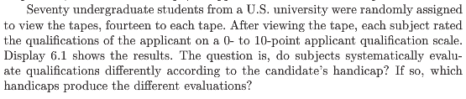
Example: Handicap and Capability Study
Goal: How do physical handicaps affect perception of employment qualification?
(Cesare, Tannenbaum, and Dalessio “Interviewers’ decisions related to applicant handicap type and rater empathy” (1990) Human Performance)
The researchers prepared five video taped job interviews with the same actors.
The tapes differed only in the handicap of the applicant:
No handicap (this is the control group)
One leg amputated
Crutches
Hearing impaired
Wheelchair
Fourteen students were randomly assigned to each tape to rate applicants: 0–10 pts (70 students total).

Slide 4
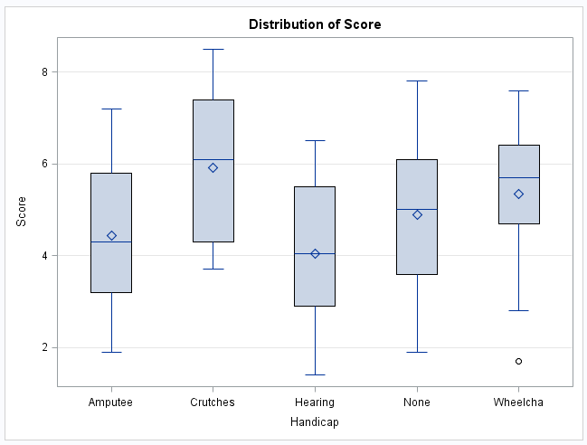
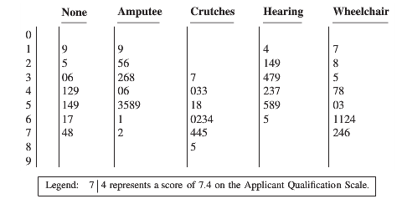
Example: Handicap and Capability Study (cont.)
Do subjects systematically evaluate qualifications differently according to handicap?
If so, which handicaps are evaluated differently?

Slide 5







Is There Any Difference at All?
We should begin any analysis involving several groups by using the ANOVA framework
If there isn’t any (statistically) significant difference in the population means, then there is no reason to address more refined questions
The tapes differed only in the handicap of the applicant:
No handicap (this is the control group)
One leg amputated
Crutches
Hearing impaired
Wheelchair
$${(μ}_{None})$$
$${(μ}_{Amp})$$
$${(μ}_{Crutch})$$
$${(μ}_{Hear})$$
ANOVA: $H_{0}:μ_{1}$=$μ_{2}$=$μ_{3}$=$μ_{4}$=$μ_{5}$
$${(μ}_{Wheel})$$
$H_{A}:μ_{j}≠μ_{k}$ for some $j,k$

Slide 6
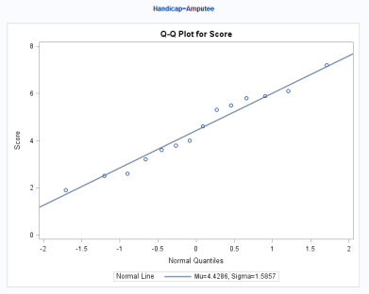
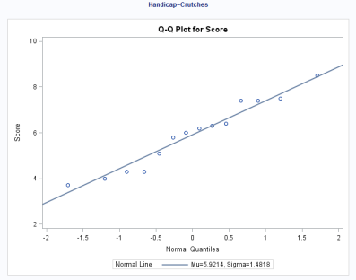
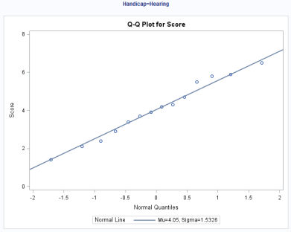
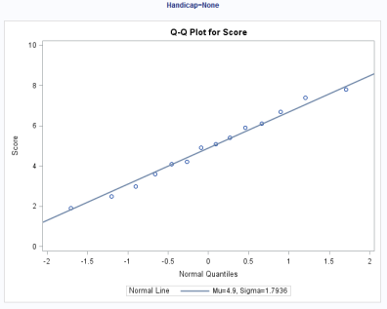
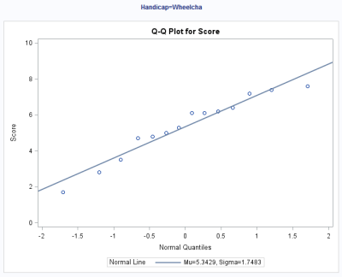
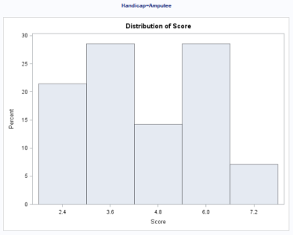
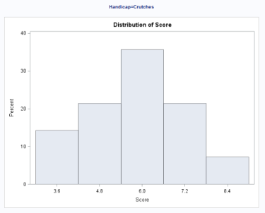
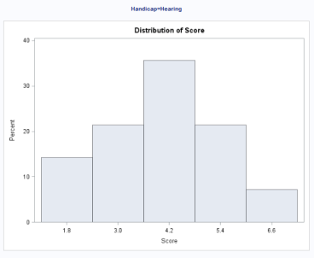
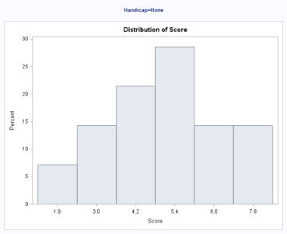
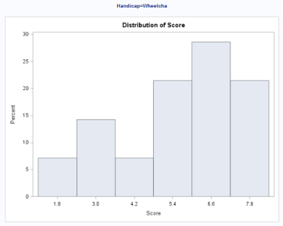
Handicap and Capability Study: Normality Assumption
There is no visual evidence to suggest that the data are not normally distributed. We will proceed with the assumption of normally distributed groups.

Slide 7
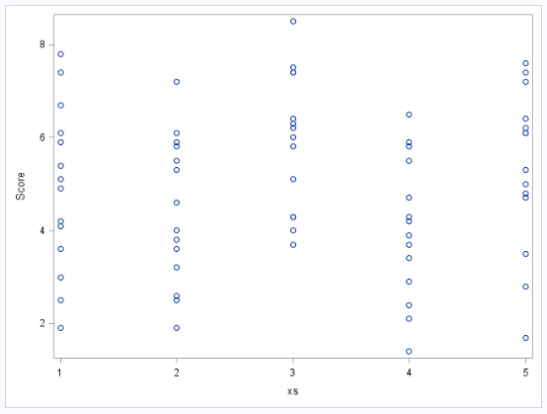
Handicap and Capability Study: Equal Variances Assumption
There is no evidence to suggest variances are unequal.

Slide 8
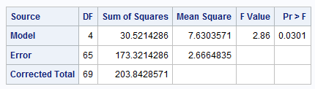
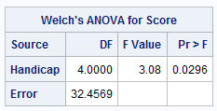


Handicap and Capability Study: ANOVA results
$H_{0}:μ_{1}$=$μ_{2}$=$μ_{3}$=$μ_{4}$=$μ_{5}$ ($μ$)
$H_{A}:μ_{j}≠μ_{k}$ for some $j,k$
There is sufficient evidence to support the claim that at least two population means are different from each other (p-value of 0.0301 from a one-way ANOVA).
Notice that since there is virtually no evidence of a difference in standard deviations, Welch’s test is almost identical to the pure F ANOVA.

Slide 9

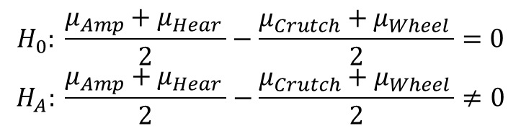
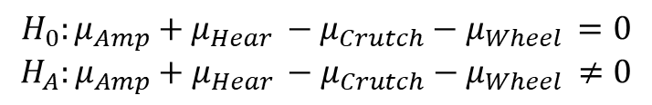

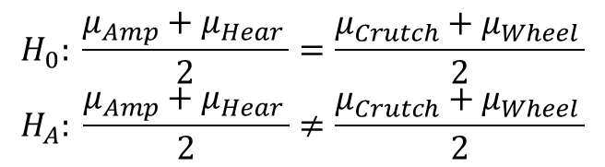

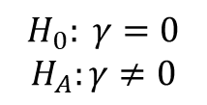

Handicap and Capability Study: More Specific Questions
$$H_{0}: \frac{μ_{Amp}+μ_{Hear }}{2}=\frac{μ_{Crutch}+μ_{Wheel }}{2}$$
$$H_{A}: \frac{μ_{Amp}+μ_{Hear }}{2}≠\frac{μ_{Crutch}+μ_{Wheel }}{2}$$
$$↕$$
$$H_{0}: \frac{μ_{Amp}+μ_{Hear }}{2}−\frac{μ_{Crutch}+μ_{Wheel }}{2}=0$$
$$H_{A}: \frac{μ_{Amp}+μ_{Hear }}{2}−\frac{μ_{Crutch}+μ_{Wheel }}{2}≠0$$
$$↕$$
$$H_{0}:{μ_{Amp}+μ_{Hear }−μ}_{Crutch}−μ_{Wheel }=0$$
$$H_{A}:{μ_{Amp}+μ_{Hear }−μ}_{Crutch}−μ_{Wheel }≠0$$
$$↕$$
(contrast)
$γ=1μ_{amp }−1μ_{Crutch }$ $+1μ_{Hear }$ $+0μ_{None }−1μ_{Wheel}$
$$↔$$
$${ H}_{0}: γ=0$$
$$H_{A}:γ≠0$$

Slide 10



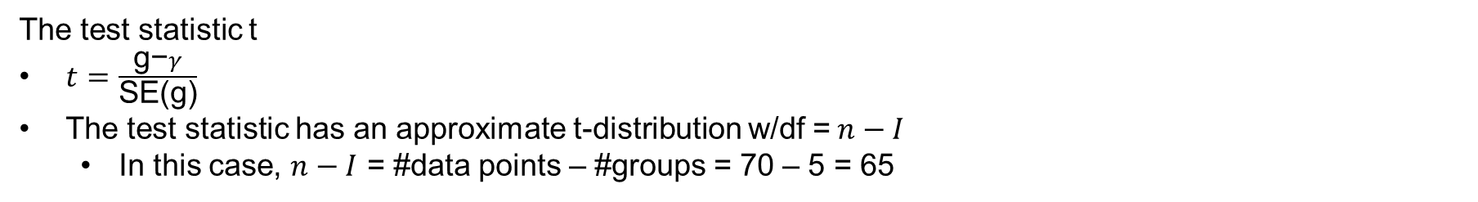

Linear Combinations and Contrasts
(Constraint: $C_{1}+C_{2}+ ⋯+C_{I}=0$)
(this requires independence)
Example: $γ=1μ_{Amp}−1μ_{Crutch}$ $+1μ_{Hear}$ $+0μ_{None}−1μ_{Wheel}$
The test statistic t
$t=\frac{\text{g}\text{−}γ}{\text{SE}\text{(}\text{g}\text{)}}$
The test statistic has an approximate t-distribution w/df =$n−I$
In this case, $n−I$ = #data points – #groups = 70 – 5 = 65

Slide 11
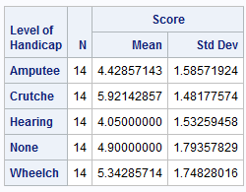
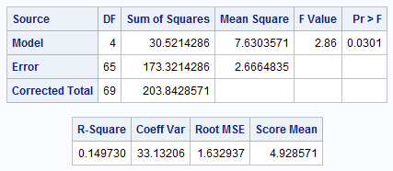
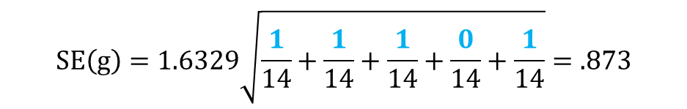
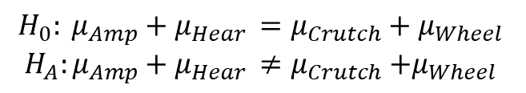
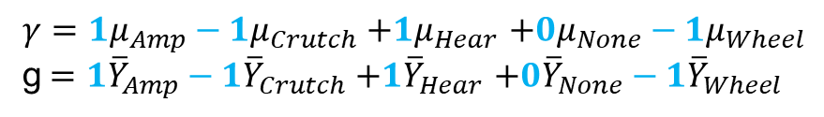
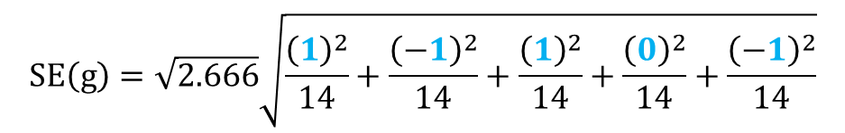
Handicap and Capability Study: A Contrast
Calculate mean difference and standard error.
$$H_{0}: μ_{Amp}+μ_{Hear }=μ_{Crutch}+μ_{Wheel }$$
$$H_{A}:μ_{Amp}+μ_{Hear }≠μ_{Crutch}{+μ}_{Wheel }$$
$γ=1μ_{Amp}−1μ_{Crutch}$ $+1μ_{Hear}$ $+0μ_{None}−1μ_{Wheel}$
g$=1{\overline{Y}}_{Amp}−1{\overline{Y}}_{Crutch}$ $+1{\overline{Y}}_{Hear}$ $+0{\overline{Y}}_{None}−1{\overline{Y}}_{Wheel}$
$g=\left(1\right)4.4−\left(1\right)5.9$ + ($1$)4.1 + (0)4.9 – ($1$)5.3 = - 2.8
$$SE\left(g\right)=\sqrt{2.666}\sqrt{\frac{{\left(1\right)}^{2}}{14}+\frac{{\left(−1\right)}^{2}}{14}+\frac{{\left(1\right)}^{2}}{14}+\frac{{\left(0\right)}^{2}}{14}+\frac{{\left(−1\right)}^{2}}{14}}$$
$$SE\left(g\right)=1.6329\sqrt{\frac{1}{14}+\frac{1}{14}+\frac{1}{14}+\frac{0}{14}+\frac{1}{14}}=.873$$

Slide 12
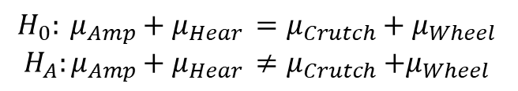
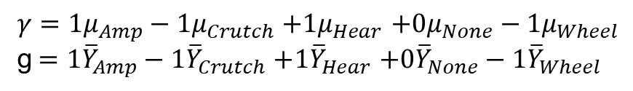


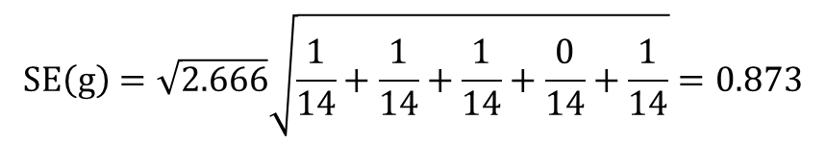

Handicap and Capability Study: A Contrast (cont.)
Confidence intervals for $γ$
$$H_{0}: μ_{Amp}+μ_{Hear }=μ_{Crutch}+μ_{Wheel }$$
$$H_{A}:μ_{Amp}+μ_{Hear }≠μ_{Crutch}{+μ}_{Wheel }$$
$γ=1μ_{Amp}−1μ_{Crutch}$ $+1μ_{Hear}$ $+0μ_{None}−1μ_{Wheel}$
g$=1{\overline{Y}}_{Amp}−1{\overline{Y}}_{Crutch}$ $+1{\overline{Y}}_{Hear}$ $+0{\overline{Y}}_{None}−1{\overline{Y}}_{Wheel}$
$g=\left(1\right)4.4−\left(1\right)5.9$ + (1)4.1 + (0)4.9 – (1)5.3 = –2.8
$$SE\left(g\right)=\sqrt{2.666}\sqrt{\frac{1}{14}+\frac{1}{14}+\frac{1}{14}+\frac{0}{14}+\frac{1}{14}}=0.873$$
CI for the difference of sums: point estimate ± multiplier* standard error
95% t-tools CI for $γ$: $−2.78577 ±(1.9971)(0.87286)$
95% t-tools CI for $γ$: $−2.78577 ±1.74319$
95% t-tools CI for $γ$: (-4.529, -1.043)
There is sufficient evidence that the sum of points assigned to Amp & Hear handicaps is smaller than the sum of points assigned to Crutch & Wheel handicaps at level alpha equal to 0.05 because the CI does not contain 0.
CI for the difference of means
(–4.529/2, –1.043/2)
(–2.2645, –0.5215)

Slide 13
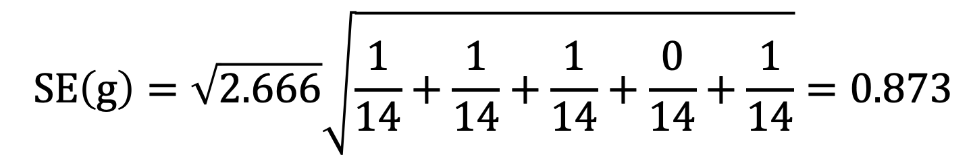
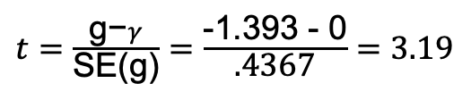
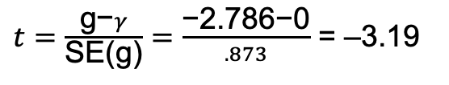
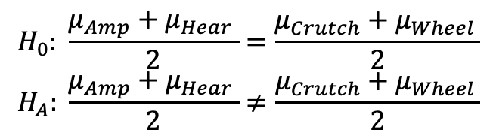




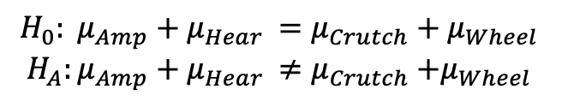
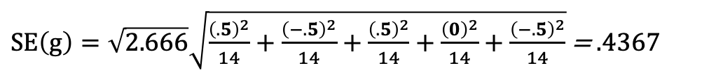
Handicap and Capability Study: In Six Steps
$$H_{0}: μ_{Amp}+μ_{Hear }=μ_{Crutch}+μ_{Wheel }$$
$$H_{A}:μ_{Amp}+μ_{Hear }≠μ_{Crutch}{+μ}_{Wheel }$$
$$H_{0}: \frac{μ_{Amp}+μ_{Hear }}{2}=\frac{μ_{Crutch}+μ_{Wheel }}{2}$$
$$H_{A}: \frac{μ_{Amp}+μ_{Hear }}{2}≠\frac{μ_{Crutch}+μ_{Wheel }}{2}$$
$SE\left(g\right)=\sqrt{2.666}\sqrt{\frac{{\left(.5\right)}^{2}}{14}+\frac{{\left(−.5\right)}^{2}}{14}+\frac{{\left(.5\right)}^{2}}{14}+\frac{{\left(0\right)}^{2}}{14}+\frac{{\left(−.5\right)}^{2}}{14}}$ = $\text{.4367}$
$t=\frac{\text{g}\text{−}γ}{\text{SE}\text{(}\text{g}\text{)}}=$ $\frac{\text{−2.786−0}}{.873}$ = –3.19
$t=\frac{\text{g}\text{−}γ}{\text{SE}\text{(}\text{g}\text{)}}=$ $\frac{\text{−}\text{1.393 }\text{−} \text{0}}{\text{.4367}}=3.19$
$$pvalue= .0022$$
$$pvalue=0.0022$$
$$Reject Ho$$
$$Reject Ho$$
There is strong evidence to suggest that the sum of the means of the amputee and hearing groups is less than that of the crutches and wheelchair groups. (p-value = 0.0022) A 95% confidence interval for the difference is (–4.529, –1.043) points.
There is strong evidence to suggest that the average of the means of the amputee and hearing groups is less than that of the crutches and wheelchair groups. (p-value = 0.0022) A 95% confidence interval for the difference is (–2.2645, –0.5215) points.

Slide 14
Handicap and Capability Study: To the Client
There is strong evidence to suggest that the average of the means of the amputee and hearing groups is less than the average of the means of the crutches and wheelchair groups (p-value = 0.0022). We are 95% confident that the average of the mean scores of the crutches and wheelchair groups are between 0.5215 and 2.2645 points more than that of the average of the mean points of the amputee and hearing groups.

Slide 16
Linear Combinations of Group Means in SAS

Slide 17
Handicap and Capability Study: A Contrast (cont.)
Confidence intervals for $γ$
$$H_{0}: μ_{Amp}+μ_{Hear }=μ_{Crutch}+μ_{Wheel }$$
$$H_{A}:μ_{Amp}+μ_{Hear }≠μ_{Crutch}{+μ}_{Wheel }$$
$γ=1μ_{Amp}−1μ_{Crutch}$ $+1μ_{Hear}$ $+0μ_{None}−1μ_{Wheel}$
g$=1{\overline{Y}}_{Amp}−1{\overline{Y}}_{Crutch}$ $+1{\overline{Y}}_{Hear}$ $+0{\overline{Y}}_{None}−1{\overline{Y}}_{Wheel}$
$g=\left(1\right)4.4−\left(1\right)5.9$ + (1)4.1 + (0)4.9 – (1)5.3 = –2.8
$$SE\left(g\right)=\sqrt{2.666}\sqrt{\frac{1}{14}+\frac{1}{14}+\frac{1}{14}+\frac{0}{14}+\frac{1}{14}}=0.873$$
CI for the difference of sums: point estimate ± multiplier* standard error
95% t-tools CI for $γ$: $−2.78577 ±(1.9971)(0.87286)$
95% t-tools CI for $γ$: $−2.78577 ±1.74319$
95% t-tools CI for $γ$: (-4.529, -1.043)
There is sufficient evidence that the sum of points assigned to Amp & Hear handicaps is smaller than the sum of points assigned to Crutch & Wheel handicaps at level alpha equal to 0.05 because the CI does not contain 0.
CI for the difference of means
(–4.529/2, –1.043/2)
(–2.2645, –0.5215)

Slide 18
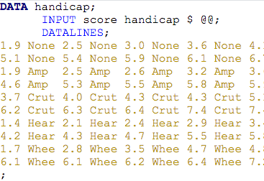
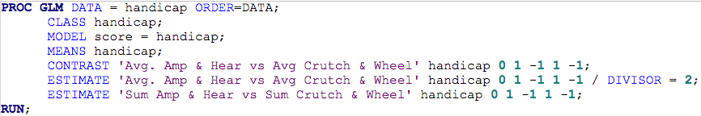

Handicap and Capability Study: In SAS, Part I
Order = data keeps the data in the order it came in, so that “none” group is first and can be assigned a coefficient of 0.
Comes in handy when doing division by hand would result in the need to input a rounded number (example 0.33)

Slide 19

Handicap and Capability Study: In SAS, Part II
$γ=1μ_{Amp}−1μ_{Crutch}$ $+1μ_{Hear}$ $+0μ_{None}−1μ_{Wheel}$
$γ=0.5μ_{Amp}−0.5μ_{Crutch}$ $+0.5μ_{Hear}$ $+0μ_{None}−0.5μ_{Wheel}$
Three different ways (contrast, estimate, estimate with divisor = 2) to test for the same idea. (There are many more than three!)

Slide 20
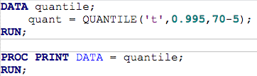

Handicap and Capability Study: In SAS, Part III
Confidence Intervals
There is sufficient evidence that the average points assigned to Amp & Hear handicaps is smaller than the average points assigned to Crutch & Wheel handicaps (t-tools linear contrast p-value of 0.0022). We estimate that this difference is –1.39 pts with an associated 99% confidence interval of …
99% CI for the difference in averages of Amp and Hear vs. Crutch and Wheel:
point estimate ± multiplier* standard error
–1.39 ± 2.65*0.436
–1.39 ± 1.155
(–2.55, –0.23), which does not include 0

Slide 21


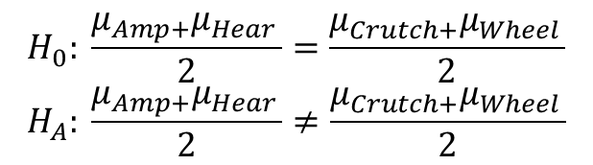
Contrast Designation
$$H_{0}: \frac{μ_{Amp+}μ_{Hear }}{2}=\frac{μ_{Crutch+}μ_{Wheel }}{2}$$
$$H_{A}: \frac{μ_{Amp+}μ_{Hear }}{2}≠\frac{μ_{Crutch+}μ_{Wheel }}{2}$$
$γ=1μ_{Amp}−1μ_{Crutch}$ $+1μ_{Hear}$ $+0μ_{None}−1μ_{Wheel}$
With no order = data in the code, the contrasts are assigned in alphabetical order, so that “none” group is fourth.

Slide 22
Let’s do an example in SAS!

Slide 24
Multiple Comparison Procedures Example
Handicap Study

Slide 25
Handicap/Capability Study: Data

Slide 26
Handicap Data Analysis
Questions of interest
1. Is there any evidence that at least one pair of mean qualification scores are different from each other?
2. Let’s say we are only interested in Amputee vs. None. Test the claim the Amputee has a different mean score than the None group.
3. Now let’s assume that we are interested in identifying specific differences between any two of the group means. Find evidence of any differences in the means between the groups.
4. Next, assume that we were interested in testing the means of the handicapped groups to the non-handicap group. Test this claim and identify any significant differences.

Slide 27
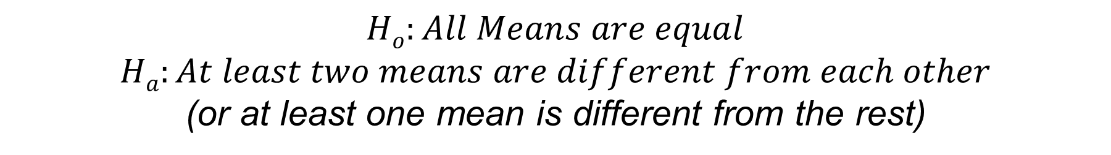
First Test!
$$Ho:All Means are equal$$
$$Ha:At least two means are different from each other$$
(or at least one mean is different from the rest)

Slide 28
Normality: Handicap Data
There is no visual evidence to suggest that the data are not normally distributed. We will proceed with the assumption of normally distributed groups.

Slide 29
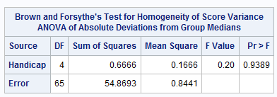
Homogeneity of SD Assumption
There is no evidence to suggest variances are unequal.
Independence may be violated here. We are going to proceed anyway for the sake of the example.

Slide 30
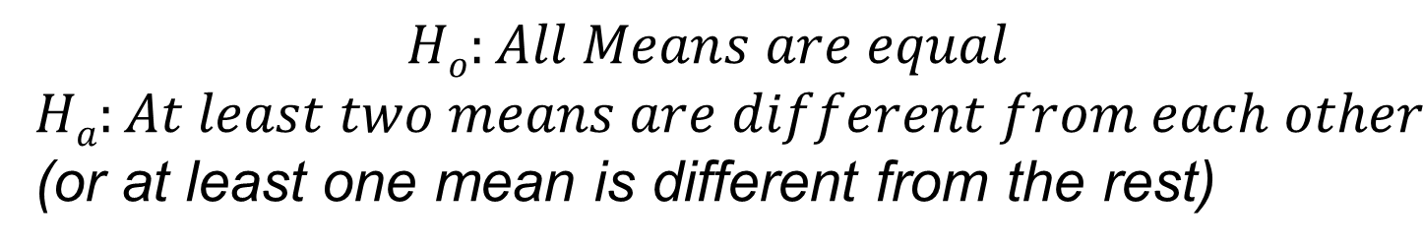
First QOI!
1. Is there any evidence that at least one pair of mean qualification scores are different from each other?
$$Ho:All Means are equal$$
$$Ha:At least two means are different from each other$$
(or at least one mean is different from the rest)
There is sufficient evidence to suggest at the alpha = 0.05 level of significance (p-value = 0.0301) that at least two of the means are different from each other in this standard ANOVA.

Slide 31
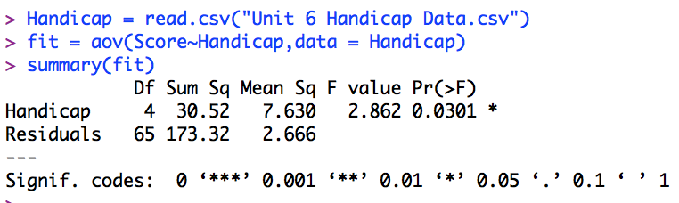
R Code for Handicap Example Question 1
Question 1: reading in data and ANOVA

Slide 32
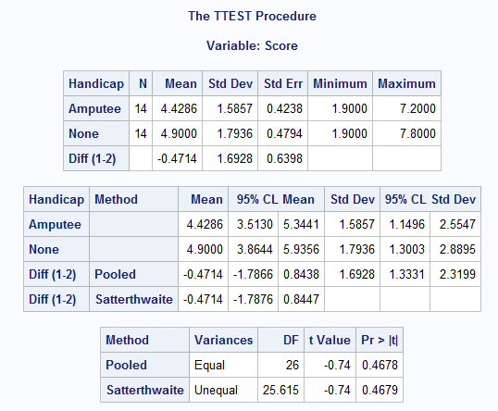
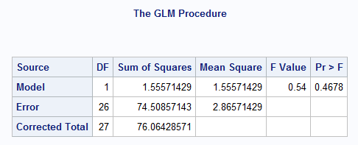


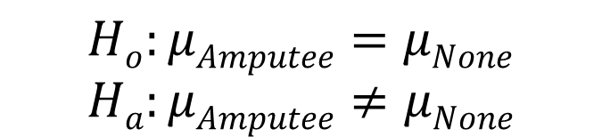
Second QOI!
2. Let’s say we are only interested in Amputee vs. None. Test the claim the Amputee has a different mean score than the None group.
$$Ho:μAmputee=μNone$$
$$Ha:μAmputee≠μNone$$
The results of these tests are equivalent! There is not sufficient evidence to suggest that the mean qualification rating of the amputee group is different than the group without handicap. (p-value = 0.4678 from a t-test and an ANOVA using only these two groups.)

Slide 33
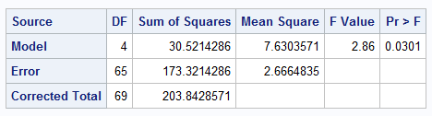


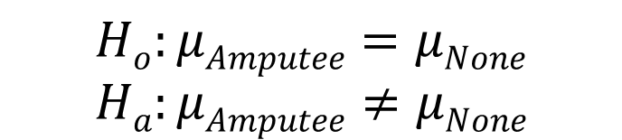
Second QOI: Better Approach!
2. Let’s say we are only interested in Amputee vs. None. Test the claim the Amputee has a different mean score than the None group.
$$Ho:μAmputee=μNone$$
$$Ha:μAmputee≠μNone$$
There is not sufficient evidence to suggest that the mean qualification rating of the amputee group is different than the group with no handicap (p-value = 0.4477 from a contrast using all available data). Even though the p-values for the two tests are only slightly different, it is better to use all available data (the procedure on the right) since it yields more degrees of freedom (65 v. 26) to estimate the standard error and thus a more powerful test. .

Slide 34
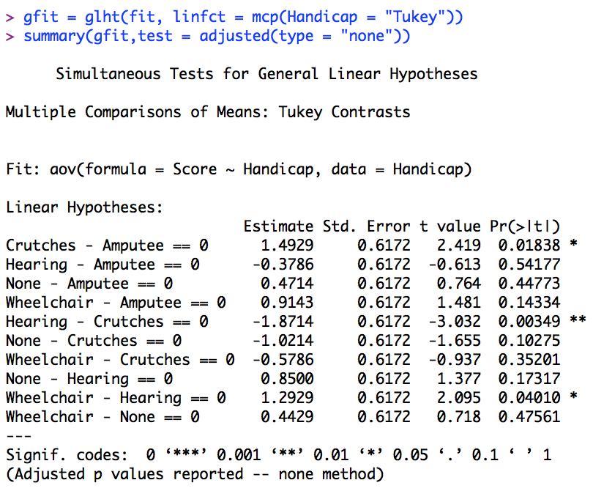


R Code for Handicap Example Question 2
Note: Must Load multcomp package
Note: Must Load pairwiseCI package

Slide 35



Third QOI!
Now let’s assume that we are interested in identifying specific differences between any two group means. Find evidence of any differences in the means between the groups.
There are 10 different two-sided tests conducted here; thus, we need to adjust alpha per test to be 0.05/10 = 0.005. With this adjustment, only one of the tests has a statistically significant result. Therefore, there is evidence (p-value = 0.0035 from a t-test) that the crutches and hearing groups have different mean qualification rating scores. We will provide a confidence interval in a few slides.

Slide 36


Bonferroni Adjusted P-Values
P-values not adjusted—compare to individual alpha
P-values adjusted—compare to family-wise alpha
Compare to alpha = 0.005
Compare to alpha = 0.05
x 10, up to 1

Slide 37

Comparison with Bonferroni
$$Pvalue= \frac{α}{k}$$
$$k∗Pvalue=α$$

Slide 38
Bonferroni Adjusted P-Values
P-values not adjusted—compare to individual alpha
P-values adjusted—compare to family-wise alpha
Compare to alpha = 0.005
Compare to alpha = 0.05
x 10, up to 1

Slide 39


Third QOI!
Now let’s assume that we are interested in identifying specific differences between any two group means. Find evidence of any differences in the means between the groups.
A 95% (Bonferroni adjusted) confidence interval for the difference in means of the crutches and hearing groups is (0.0779, 3.66499).

Slide 40


Third QOI! (cont.)
Now let’s assume that we are interested in identifying specific differences between any two group means. Find evidence of any differences in the means between the groups.
A 95% (Bonferroni adjusted) confidence interval for the difference in means of crutches and hearing groups is (0.0779, 3.66499).
*Slightly different code from the last slide, producing slightly different output. Note the cl vs. cldiff.

Slide 41


R Code for Handicap Example Question 3
Note: Must Load multcomp package

Slide 42


4th QOI: Next, assume that we are interested in testing the means of the handicapped groups with the non-handicapped group. Test this claim and identify any significant differences.
There is not sufficient evidence in this study to suggest that there are any differences between the means of each handicap group and the mean of the group without handicap.
The 95% family-wise confidence intervals are constructed using Dunnett’s procedure. All CIs contain zero, thus not providing sufficient evidence to conclude that the difference is not zero.
(The study results do not constitute sufficient evidence to support the claim that the means tested are unequal.)
Specify the control group

Slide 43


4th QOI: Next, assume that we were interested in testing the means of the handicapped groups with the non-handicap group. Test this claim and identify any significant differences.
Hypothesis tests also conclude that there is not sufficient evidence to suggest that there are any differences between the means of each handicapped group and the mean of the of the group without handicap. The above Dunnett adjusted p-values are all greater than alpha = 0.05, as is visible from the table above.

Slide 44


R Code for Handicap Example Question 4
Note: Must Load multcomp package

